Slide 1
Delay Tolerant Linear Partition
Nelson Jaimes
Rana Alsaadi
Notes:
Nelson
Hello everyone this is our project 4 presentation on
The Delay Tolerant Linear Partition problem.

Slide 2


Team Introduction
Nelson Jaimes
Specializing in Computer Science
Neuroscience background
Likes art
Rana Alsaadi
Specializing in Computer Security
Business Informatics background
Likes cats
Notes:
Rana

Slide 3
Topics Covered
Problem Definition
Problem Importance
Solution
Empirical Results
Notes:
Rana
In this presentation, we will go over
The problem definition
Problem importance
The solution
And empirical results collected from the algorithm

Slide 4
Topics Covered
Problem Definition
Introduction
Overview
Formal Definition
Problem Importance
Solution
Empirical Results
Notes:
Rana
First let’s define the problem.
We’ll introduce it, then give an overview of the problem
And then we’ll show you the formal definition.

Slide 5
Problem Introduction
5 | 4 | 6 | 3 | 8 | 4 | 16 | 11 | 20 | 60
Notes:
Nelson
After grad school, you start out as an algorithm consultant.
A ferry line in New York City asks you to design an algorithm
that figures out the weight capacity required for a ship to be able to carry n cars in k trips.
They know they need k trips because all the cars in the queue need to get to Manhattan by 9am.
They know how much each car weighs
the cars line up in a queue to reach the ferry. So, you can’t ask the cars to rearrange their order.
Also, they have a slow computer that can only find the answer if it has O(nk) time complexity.
You think back to your days in graduate algorithms class, and you realize you know how to find the answer!
First, you define your algorithm.

Slide 6
Problem Definition: Overview
6 | 8 | 3 | 7
3
Min
11
K contiguous subdivisions
n numbers of various sizes
Find minimum subdivision weight that can fit all objects in sequence
Notes:
Nelson
You can save each of the car weights as integers in an array.
You can have K contiguous subdivisions which represent each trip
You need to try to find the minimum subdivision weight to save your client money.
So if we run the algorithm on the array on this slide with 3 partitions, it should tell us that the minimum weight capacity is 11.

Slide 7
Formal Problem Definition
Let A[1:n] be a real array, and let k be an integer, 1 ≤ k ≤ n.
A linear k-partition of A
a sequence of subarrays of the form
[1:x1],[x1+1:x2],[x2+1:x3],…,[x(k-1)+1:n], for some x1< x2 <… < x(k−1).
From this, we calculate the sums of each of k subarrays.
The weight of this linear k-partition is the maximum of those sums
Goal: minimize the weight of the linear k-partition of the given array in O(nk).
http://notexponential.com/382/minimizing-weight-of-a-linear-partition
Notes:
Rana
Now, more formally, let A[1:n] be an array, and let k be an integer from 1 to n.
A linear k-partition of A
Is a sequence of k contiguous subarrays dividing the array.
The weight of that arrangement of subarrays is the maximum of the sum of the elements in each of the subarrays.
We are seeking to minimize that weight.
The problem is defined on professor Arora’s website at the address on the bottom of the slide.

Slide 8
Topics Covered
Problem Definition
Problem Importance
Solution
Empirical Results
Notes:
Rana
Now that we understand the problem definition, we can move on.

Slide 9
Topics Covered
Problem Definition
Problem Importance
Solution
Empirical Results
Notes:
Rana
We will briefly look at the problem’s importance

Slide 10
Problem Importance
Finds minimum container capacity given known weights
Has similarities to the bin packing problem
Examples
Loading trucks with weight capacity constraints ¹
Video-on-demand ²
Multiprocessor scheduling ³
Job scheduling ⁴
Cloud computing ⁵
Notes:
Nelson
This problem is important because
it can be applied in many areas,
We already saw an application in the physical world, in the problem introduction and
It also applies to any of the examples listed on this slide from academic literature.

Slide 11
Topics Covered
Problem Definition
Problem Importance
Solution
Empirical Results
Notes:
Rana
We can see this problem has wide applicability.

Slide 12
Topics Covered
Problem Definition
Problem Importance
Solution
Overview
Recursive Definition
Base Case and Next Case
Optimality
Sample Execution
Insights
Empirical Results
Notes:
Rana
Now we can move on to look at the solution.
This is the largest topic in our presentation.
And then go through the steps for a dynamic programming solution, which include
* Considering a recursive definition
* Finding the base case and next case
* Examining the optimality of the proposed algorithm,
* Walking through a sample execution
* And then sharing the key insights that allowed us to design this algorithm.

Slide 13
Solution: Overview
Use Dynamic Programming
Populate array with the minimum weights for each number of partitions and array lengths.
Reuse those minimum weights of k-1 partitions to calculate partition k’s weights
The last item calculated is the result of interest.
Notes:
Rana
We will use dynamic programming
At each possible number of partitions we will populate the array with minimum weights for all locations of the subdivision boundary and select the minimum.
This will happen for all the array lengths.
We will reuse smaller sub-problems to compute larger sub-problems until we arrive at the answer.

Slide 14
Solution: Recursive Definition
Let S[i,j] represent the minimum weight of the linear i-partition of array[1:j]
S[i,j] = min_for_all x_from_1_to_ j ( max( S[i-1,x] , sum(array[x+1:j]) )
http://notexponential.com/382/minimizing-weight-of-a-linear-partition
Notes:
Rana
Our recursive definition is simple. Each optimal value in S sub i j is
The min for all x from 1 to j of
The max between
the optimal weight of the values to the left of the boundary
And
The sum of the values to the right of the boundary until the end of the array length considered is reached.

Slide 15
Solution: Base Case and Next Case
Base Case
S[1,j] = sum(array[1:j])
Next Case
Let S[i-1,j] = minimum weight of the linear (i-1) partition of array[1:j]
Increase i from 2 to k
S[i,j] = min_for_all x_from_1_to_ j ( max( S[i-1,x] , sum(array[x+1:j]) )
S[k,n] is solution
Stored in S[n,k] array
http://notexponential.com/382/minimizing-weight-of-a-linear-partition
Notes:
Nelson
So our base case is the weight for a single partition of varying array lengths, so it is equal to the sum of the entries in the array for each sub-array length.
For our next case,
We assume S[i-1,j] contains the optimal weight of the previous number of partitions, which should be i-1 partitions, in the array that goes from the start index to j.
We increase i from 2 to k to consider all partition sizes.
To calculate the value of S[i,j] , for each possible partition location, we get the max between the previous optimal weight that we have stored, and
The sum of items from the partition to the end of the array length we are considering.
We obviously try all lengths, since this is dynamic programming.
If we follow those steps, the entry at S sub k , n is our answer for the optimal weight.

Slide 16
Solution Optimality
Optimal substructure
Weights are computed by finding the min of all relevant possibilities.
If for any index,
a weight smaller than the one selected exists
it would have been selected instead
Array S[i,j] contains the optimal weights, for i partitions and length j
http://notexponential.com/382/minimizing-weight-of-a-linear-partition
Notes:
Nelson
As we said, we consider each of all relevant possibilities and find the min of these values.
If the value we arrive it at the end is not the optimal minimum weight, there must be some partition that results in a lower max value between left and right partition.
But we considered all possible values and selected the min, so that is not possible.
Therefore, the final value must be the optimal weight.

Slide 17
Solution: Sample Execution
Notes:
Rana
We can go over a sample execution that demonstrates how sub-arrays min values are calculated by the algorithm.

Slide 18
5 | 9 | 3 | 2 | 8 | 4 | 6 | 11
2
Min
43
5
5
43
9 | 3 | 2 | 8 | 4 | 6 | 11
Notes:
We start out the left-most boundary to divide the array.
Our left value is 5, since 5 is the only element on the left side of the boundary.
Our right value is 43, since that is the sum of the values of the right side of the boundary.
We will keep that process going for boundaries going from left to right, and
We will be picking the min each time we consider a different boundary.

Slide 19
5 | 9 | 3 | 2 | 8 | 4 | 6 | 11
2
Min
34
14
5 | 9
34
3 | 2 | 8 | 4 | 6 | 11
Notes:
As you can see, we keep updating the min value and the boundary as we go along a chosen value for the number of partitions.

Slide 20
5 | 9 | 3 | 2 | 8 | 4 | 6 | 11
2
Min
31
17
5 | 9 | 3
31
2 | 8 | 4 | 6 | 11

Slide 21
5 | 9 | 3 | 2 | 8 | 4 | 6 | 11
2
Min
29
19
5 | 9 | 3 | 2
29
8 | 4 | 6 | 11

Slide 22
5 | 9 | 3 | 2 | 8 | 4 | 6 | 11
2
Min
27
27
5 | 9 | 3 | 2 | 8
21
4 | 6 | 11

Slide 23
5 | 9 | 3 | 2 | 8 | 4 | 6 | 11
2
Min
27
31
5 | 9 | 3 | 2 | 8 | 4
17
6 | 11
Notes:
Since the max value here is greater than 27, the min value will not update.

Slide 24
5 | 9 | 3 | 2 | 8 | 4 | 6 | 11
2
Min
27
5 | 9 | 3 | 2 | 8 | 4 | 6
37
11
11
Notes:
We’re done.
Now we know the min value for this array.

Slide 25
Solution: Insights (1 of 3)
5 | 9 | 3 | 2 | 8 | 4 | 6 | 11
3
Min
17
2
Min
12
2
Min
17
Min weight of (k-1 partitions) useful for min weight of (k partitions)
Notes:
Nelson
Ok so we saw how the algorithm works for a single subarray.
Now let’s look at the key insights that made the solution possible.
First and foremost, we realize that the min weight of the array with k-1 partitions is useful for calculating the min weight of k partitions.

Slide 26
Solution: Insights (2 of 3)
1 | 2 | 1 | 5
2
Min
4
1 | 2 | 1 | 5 | 8
2
Min
9
if (increasing partition lengths from left)
and (left component < right component)
boundary will not move left
Notes:
Nelson
We also realize that we can ignore some entries, which is key for getting an answer calculated in O(n * k).
If we increase the partitions considered from left to right
And the left component for some partition value is less than the right component when the min value gets calculated,
We know that partition will never get reached again for all other array lengths.
We can skip a bunch of calculations!

Slide 27
Solution: Insights (3 of 3)
5 | 9 | 3 | 2 | 8 | 4 | 6 | 11
{
3
S[i-1,j] with no delay tolerance
2
S[i-1,j]
+
Sum(j+1 : j + <delay tolerance>)
For a delay tolerant solution, add the next b items to the calculated weight of any portion of the array.
Notes:
Nelson
Finally, to add delay tolerance to our solution, we just add the next b items in the array to the weight of any portion of the array.

Slide 28
Topics Covered
Problem Definition
Problem Importance
Solution
Empirical Results
Notes:
Rana
Ok we are done going over the solution.

Slide 29
Topics Covered
Problem Definition
Problem Importance
Solution
Empirical Results
Notes:
Rana
Now we can go over empirical results.

Slide 30
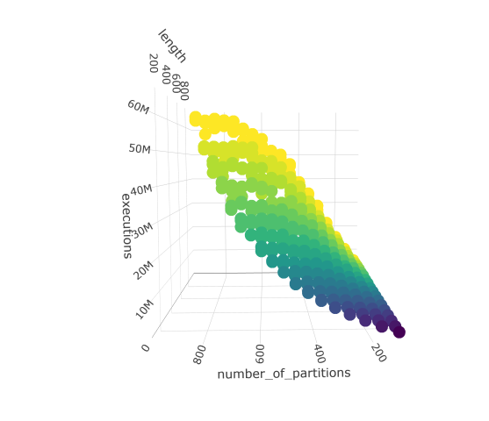
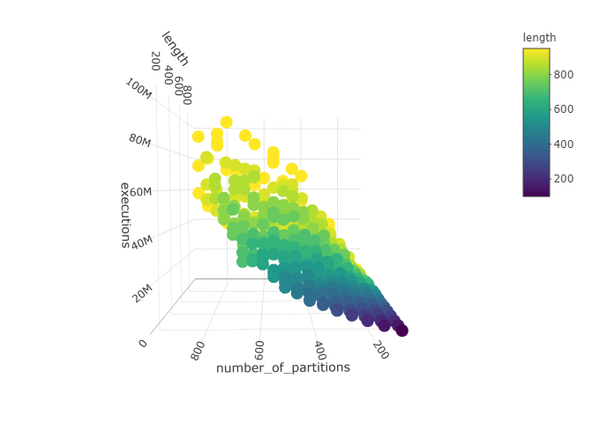
Empirical Results
60 n k = O( n k )
Notes:
Nelson
As we can see, when we change the number of partitions from 1 to 1000 and the number of items from 1 to 1000,
The number of executions peaks at around 60 million.
There is a larger efficiency gain in this algorithm as the difference between array length and number of partitions increases,
Which makes sense because there is greater opportunity to skip entries with a bigger difference!
As we can see, if we add delay tolerance the number of executions goes up to 100 n k, but that still is growing much slower than n and k.

Slide 31
References
Wikipedia “bin packing problem”
Aydın, N., Muter, İ. and Birbil, Ş.İ., 2020. Multi-objective temporal bin packing problem: An application in cloud computing. Computers & Operations Research, 121, p.104959.
Coffman, Jr, E.G., Garey, M.R. and Johnson, D.S., 1978. An application of bin-packing to multiprocessor scheduling. SIAM Journal on Computing, 7(1), pp.1-17.
Leinberger, W., Karypis, G. and Kumar, V., 1999, September. Multi-capacity bin packing algorithms with applications to job scheduling under multiple constraints. In Proceedings of the 1999 International Conference on Parallel Processing (pp. 404-412). IEEE.
Aydın, N., Muter, İ. and Birbil, Ş.İ., 2020. Multi-objective temporal bin packing problem: An application in cloud computing. Computers & Operations Research, 121, p.104959.
http://notexponential.com/382/minimizing-weight-of-a-linear-partition
Notes:
Nelson
Here are our references.

Slide 32
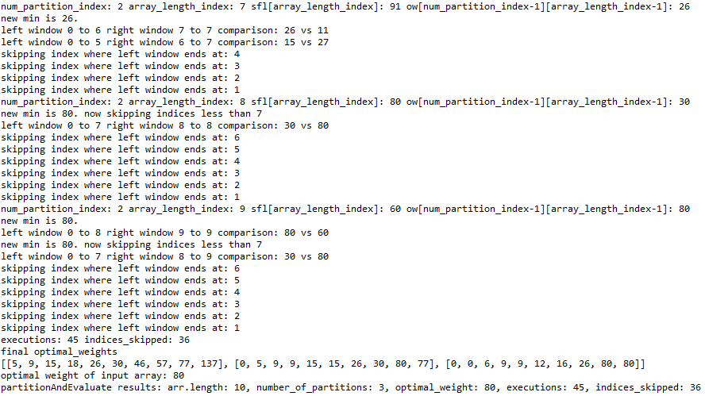
Thanks for listening!
Questions?
5 | 4 | 6 | 3 | 8 | 4 | 16 | 11 | 20 | 60
Minimum weight capacity is 80
Project github is at https://github.com/RanaAlsaadi/Project4
Notes:
Nelson
Thanks for listening!
By the way, the github address at the bottom of this slide has all the java and R code related to this project, if you are interested.
Any questions?

